Slide 1
C Project On “Department Store Bill Management System” Initial Presentation on C

Slide 2
Members Of The Project
Premi Jimee
Basanta Shrestha
Bishal Oli
Dorna Bahadur KC
CSIT 1Sem
MBM College

Slide 3
Objectives
To know the importance of programming for the departmental calculation.
To create coding system in every trading purpose.
To keep records of goods, staff etc

Slide 4
Introduction to Department Store
A departmental store is a large retail trading organization.
Departments are made as per different types of goods to be sold.
For example: selling packed food goods, garments, stationery , cosmetics, medicines, computes etc., so that consumers can purchase all basic household requirements under one roof.
The concept of a departmental store first originated in France.

Slide 5
Work of this system is :
To mention all the goods that are purchased.
To calculate the total amount.
List all the products.
Search goods.

Slide 6
Header files used in program
#include<stdio.h>
#include<conio.h>
#include<string.h>
#include<stdlib.h>
#include<graphics.h>

Slide 7
Statement Used: Control statement Array Structure String Pointer

Slide 8
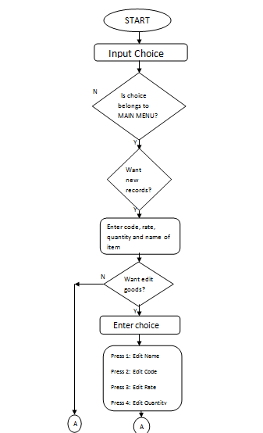
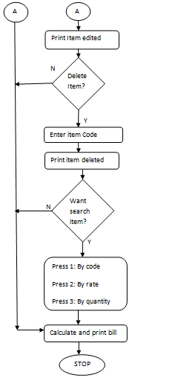
FLOWCHART

Slide 9
Thank -you

